Slide 1

Dockerizing SpringBoot Kafka
Sowjanya Morisetty
2451432

Slide 2
Apache Kafka
Apache Kafka is an open-source distributed event streaming platform used by thousands of companies for high-performance data pipelines, streaming analytics, data integration, and mission-critical applications.

Slide 3
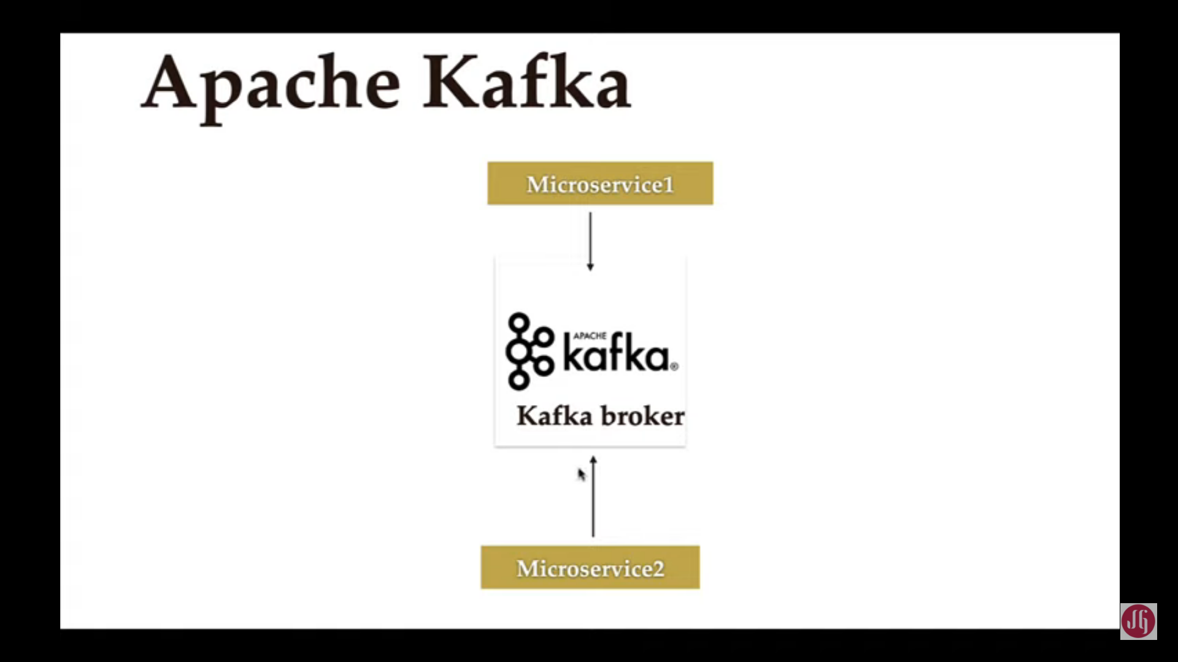
USE CASES:
Messaging
Website Activity Tracking
Metrics
Log Aggregation
Stream Processing
Event Sourcing
Commit Log

Slide 4
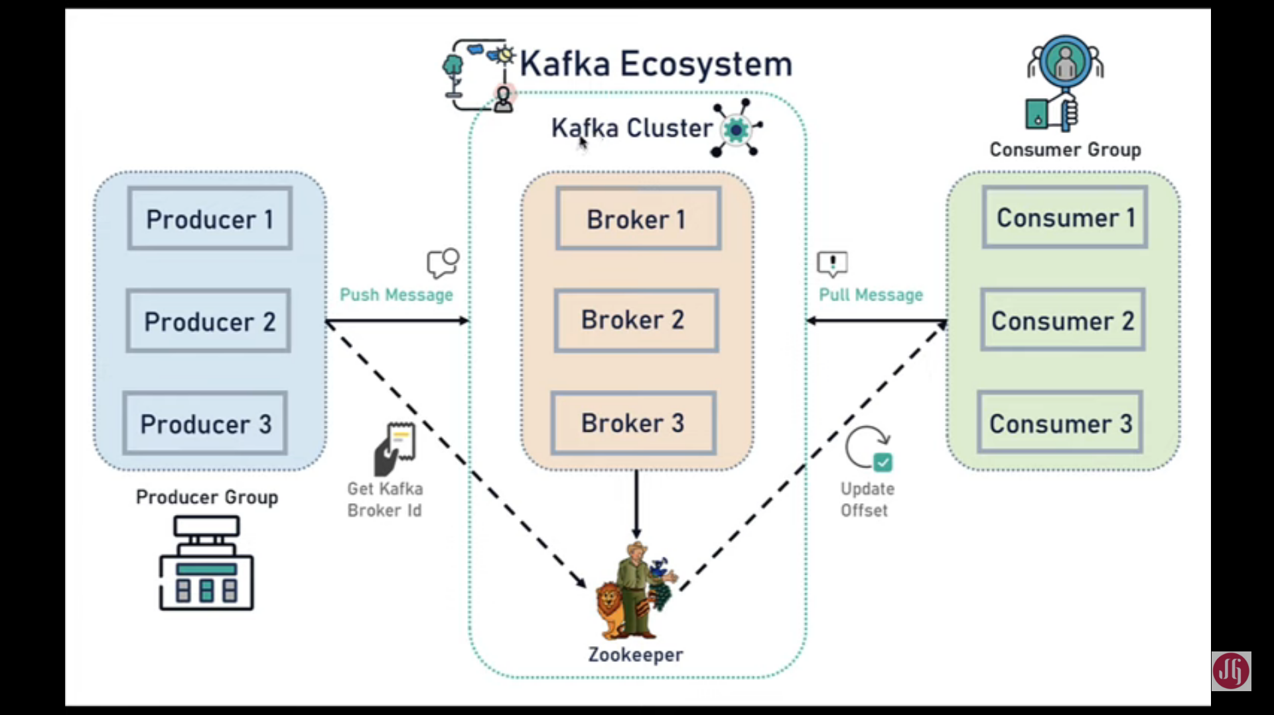

Slide 5
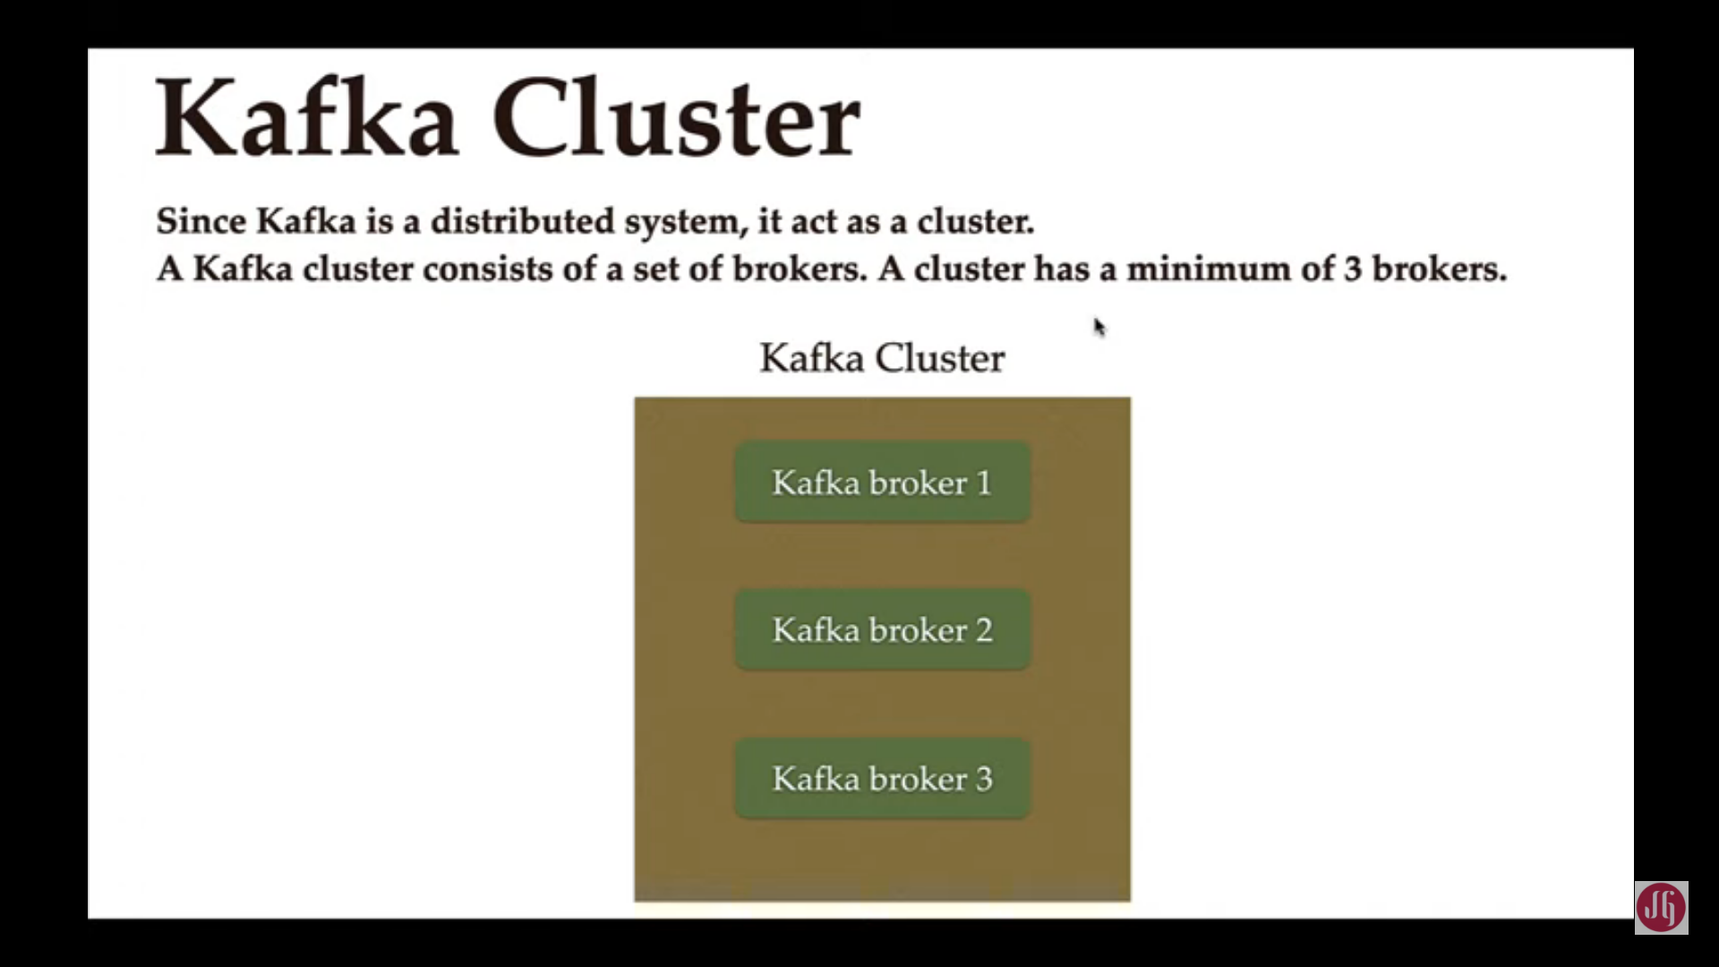
Kafka Cluster
Since , Kafka is a distribute system. It acts as a Cluster.
A Kafka Cluster consists of a set of brokers.
A cluster has a minimum of three brokers.

Slide 6
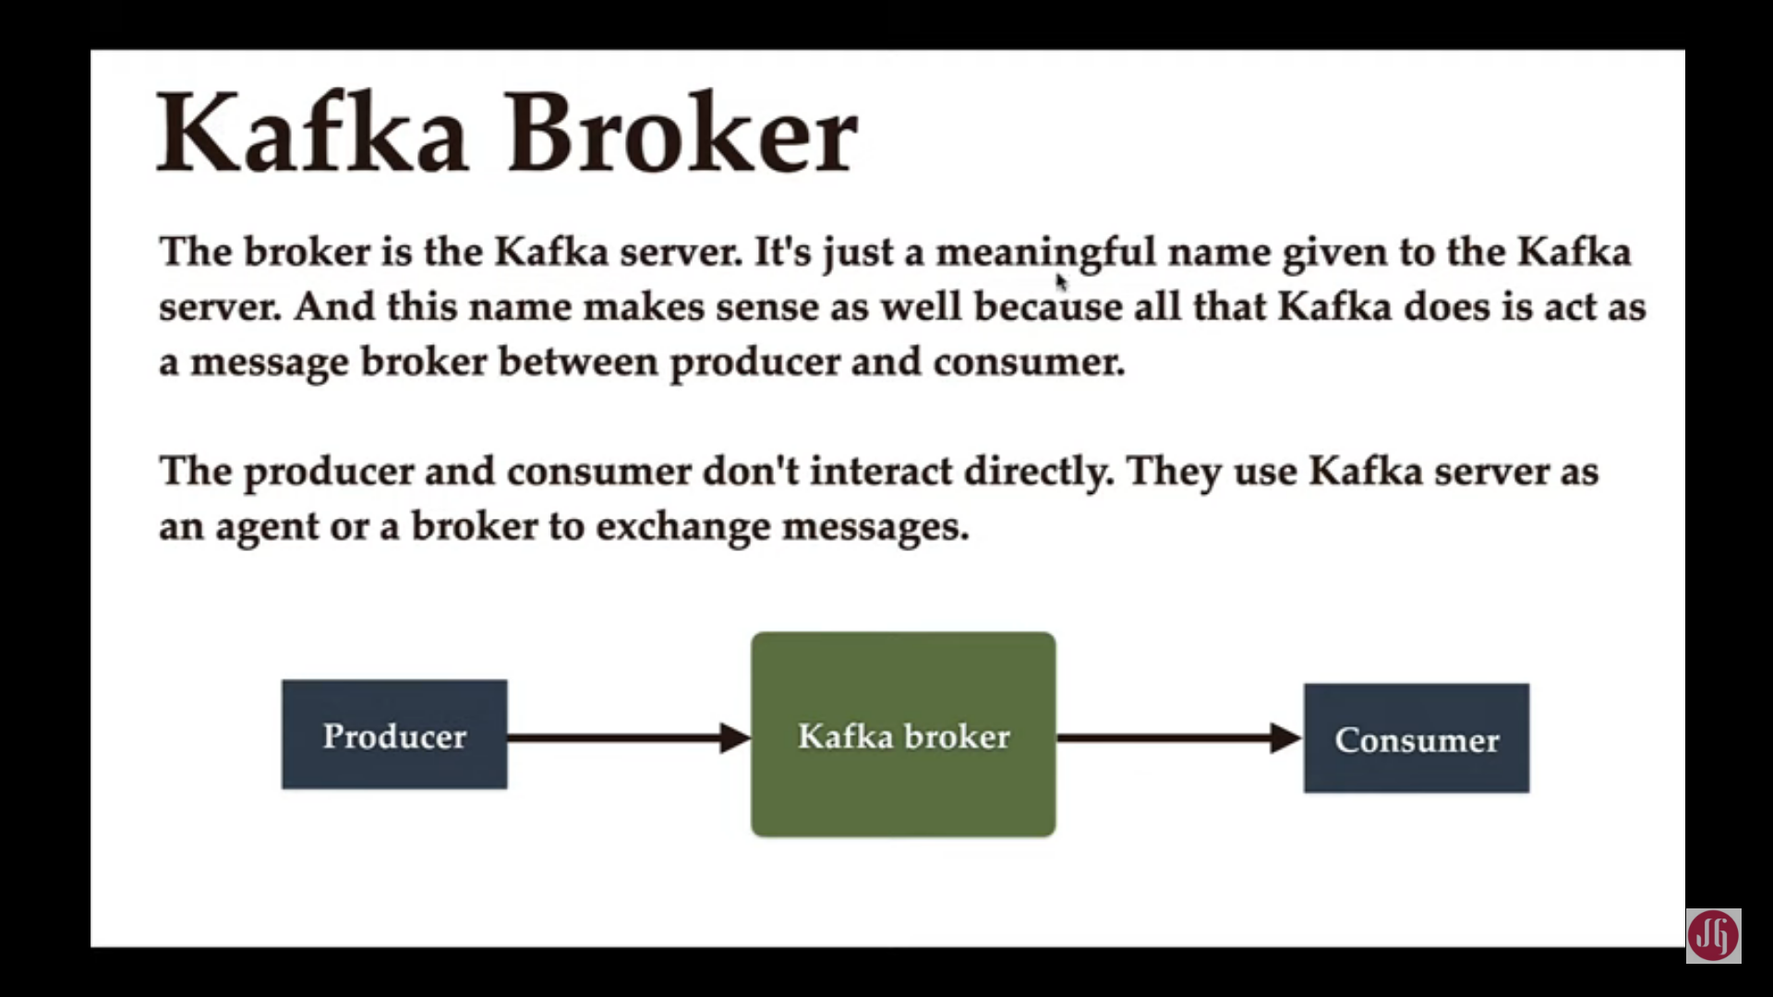
Kafka Broker
The broker is the Kafka server. It was just a meaningful name to the Kafka server
The producer and consumer do not interact directly. They use Kafka server as an agent or a broker to exchange messages

Slide 7
Producer:
Producer is an application that sends messages. It does not send messages directly to the recipient. It sends messages to the Kafka server.
Consumer:
Consumer is an application that reads messages from the Kafka server.
The consumers are the recipients. Producers sends data to the Kafka server.
Anyone who is interested in that data can come forward and take it from Kafka server. So, any application that requests data from Kafka server is a consumer, and they can ask for data send by any producer provided they have permissions to read it.

Slide 8
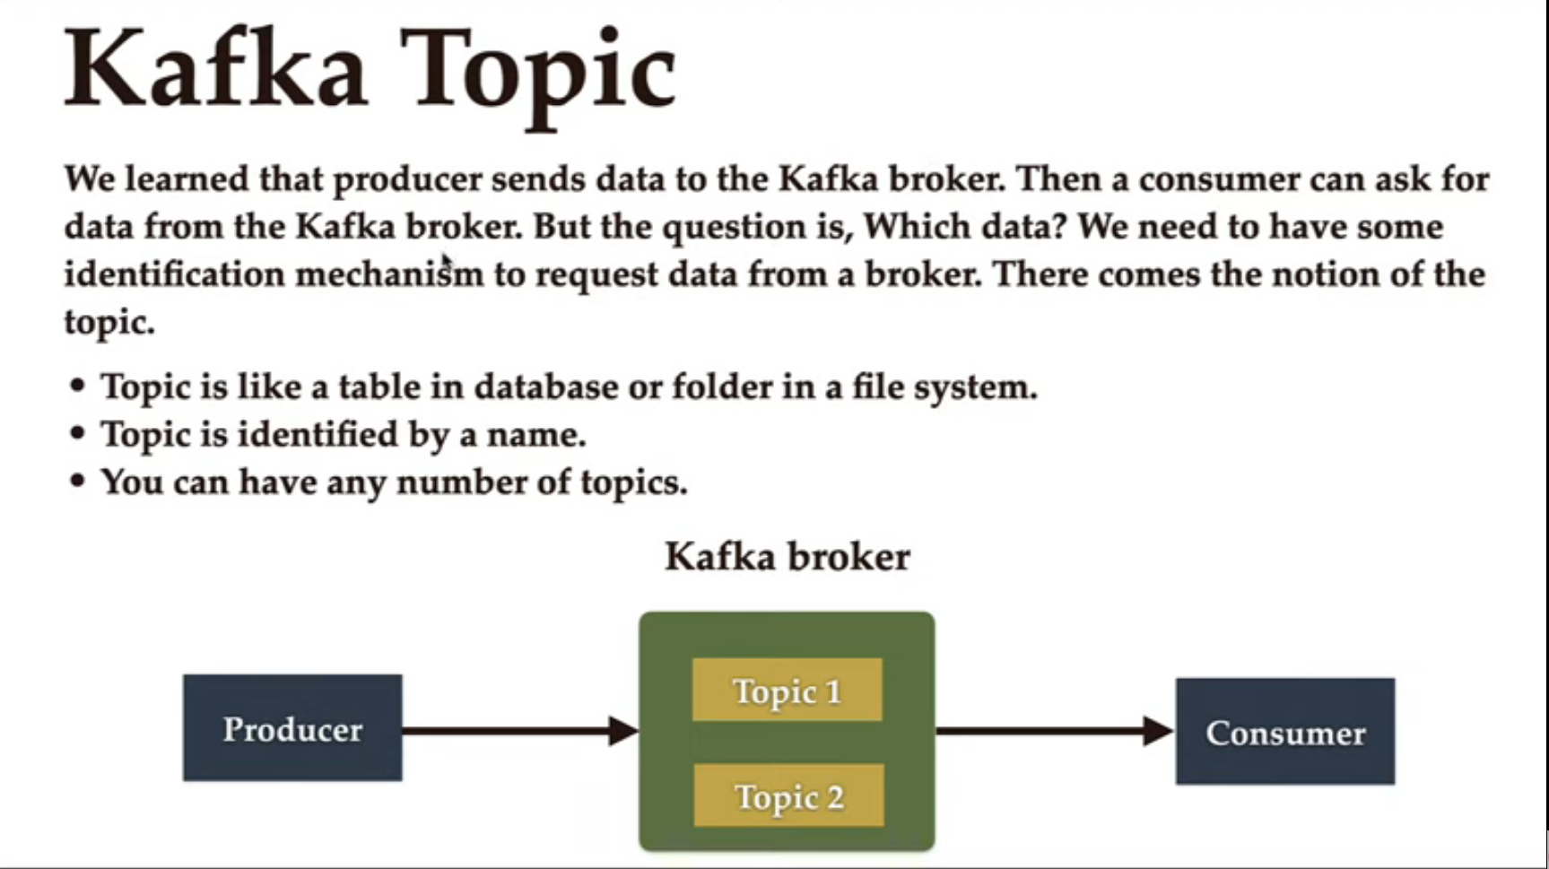

Slide 9
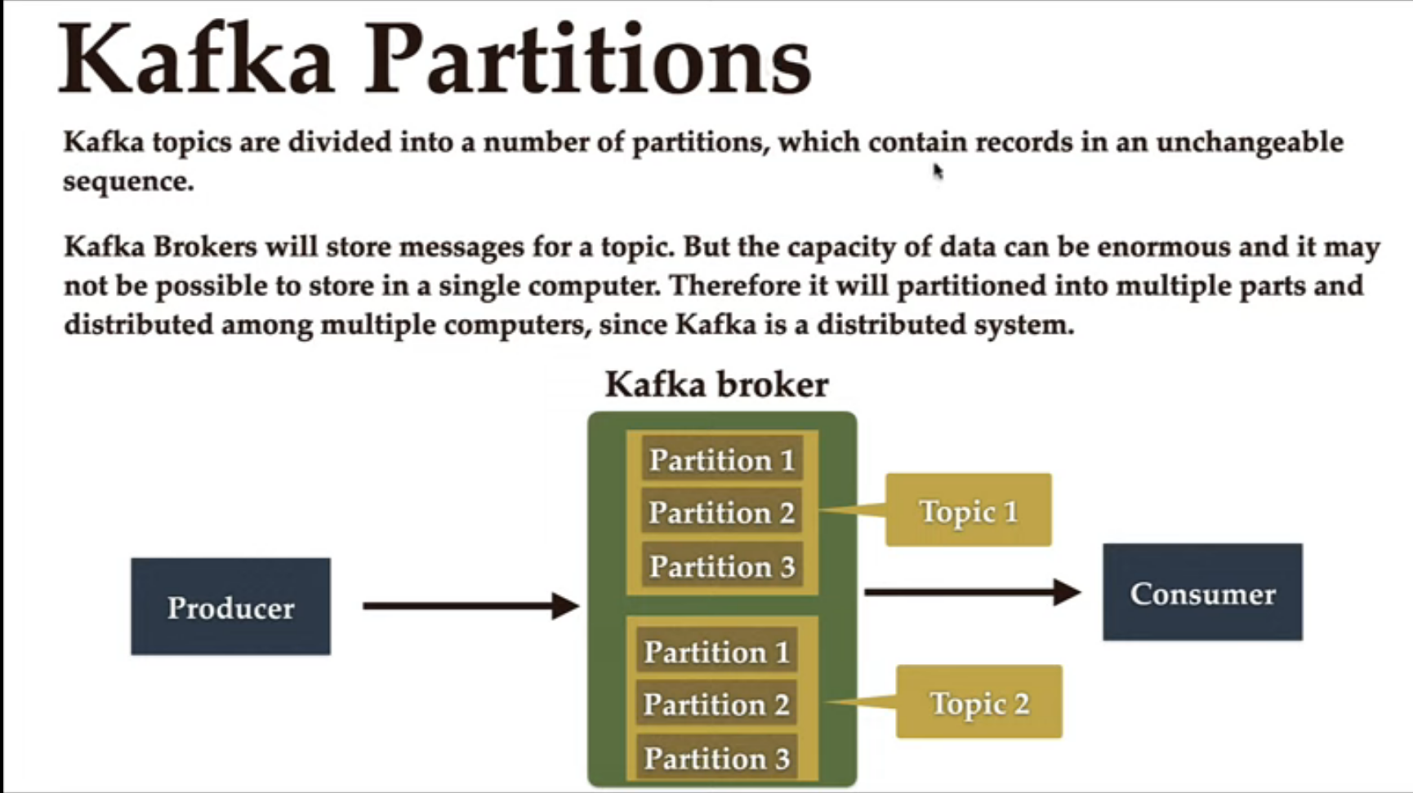

Slide 10
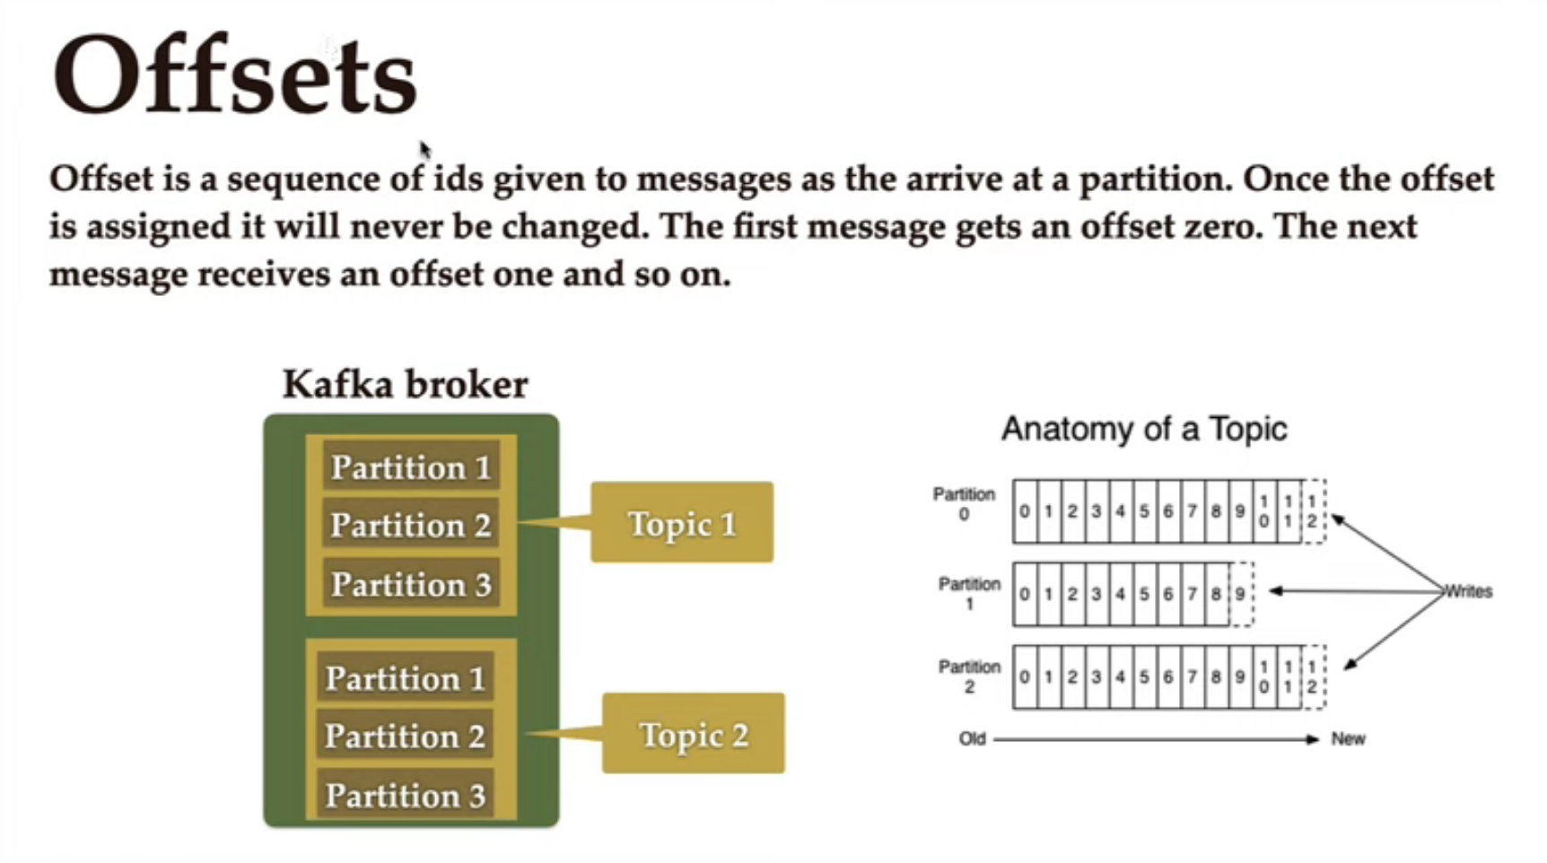

Slide 11
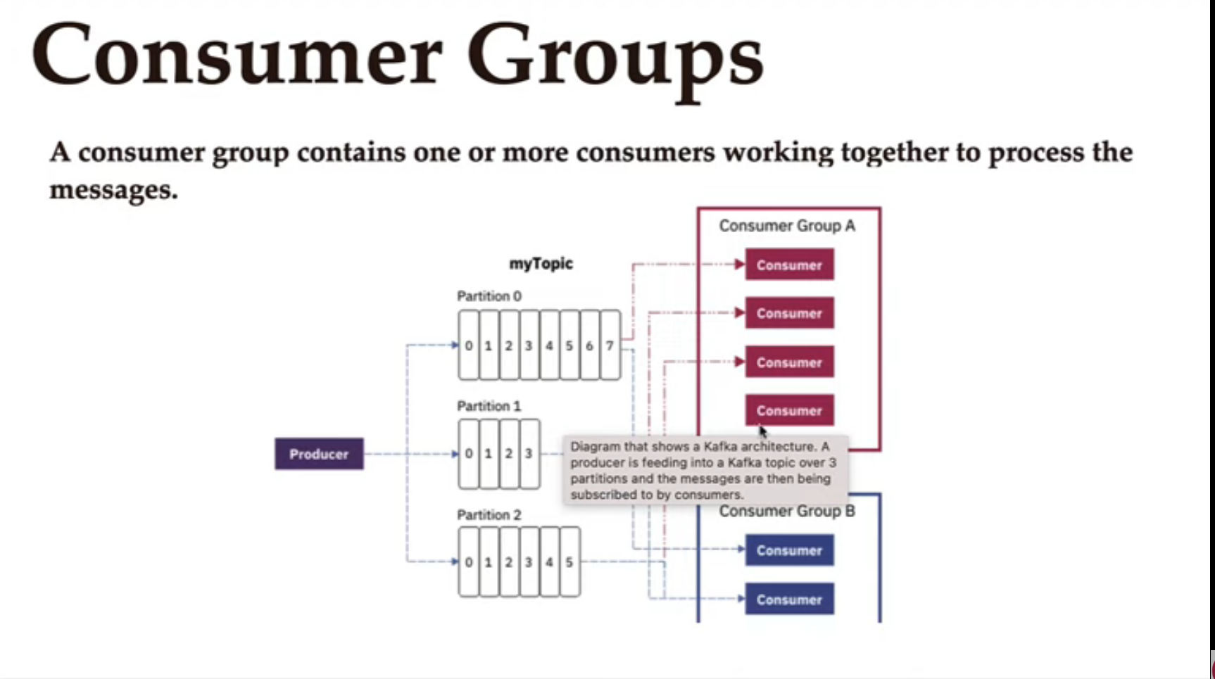

Slide 12
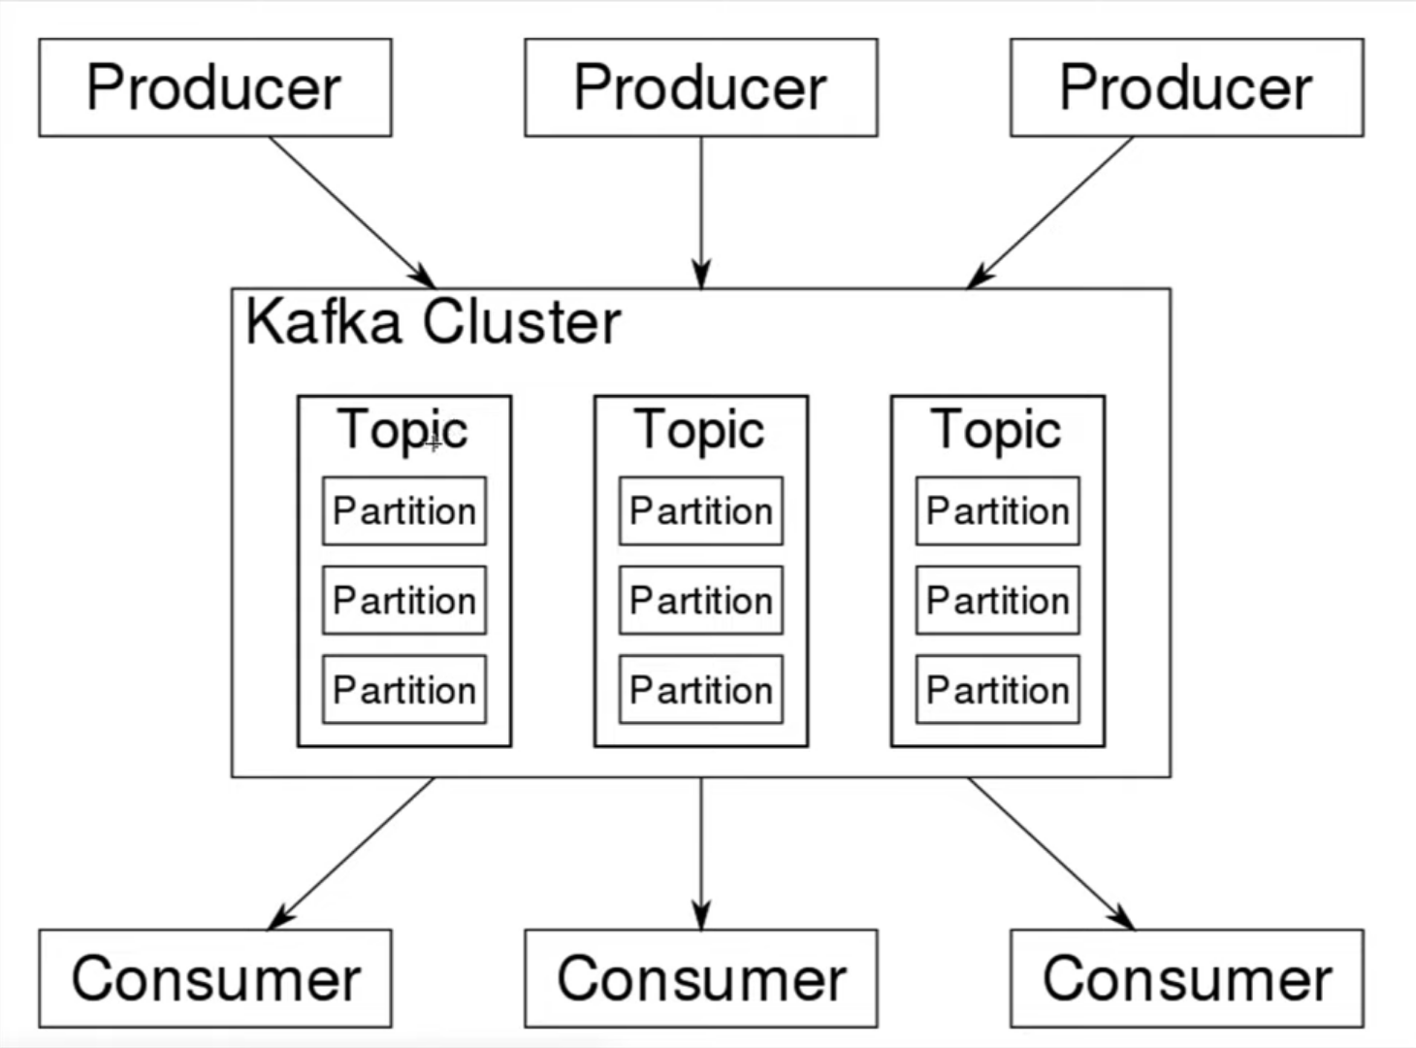

Slide 13
start zookeeper:
zookeeper-server-start.bat D:\DEV-SOFTWARES\kafka_2.12-1.1.0\config\zookeeper.properties
Start Kafka Server:
kafka-server-start.bat D:\DEV-SOFTWARES\kafka_2.12-1.1.0\config\server.properties
Create Topic:
kafka-topics.bat --create --zookeeper localhost:2181 --replication-factor 1 --partitions 1 -topic orders
Produce a message
kafka-console-producer.bat --broker-list localhost:9092 --topic javatechie
Consume a message:
kafka-console-consumer.bat --bootstrap-server localhost:9092 --topic javatechie

Slide 14
Docker-Compose File
version: '2'
services:
zookeeper:
image: wurstmeister/zookeeper
ports:
- "2182:2181"
kafka:
image: wurstmeister/kafka
ports:
- "9093:9092"
environment:
KAFKA_ADVERTISED_HOST_NAME: 127.0.0.1
KAFKA_ZOOKEEPER_CONNECT: zookeeper:2181
KAFKA_CREATE_TOPICS: "test_topic:1:3"

Slide 15
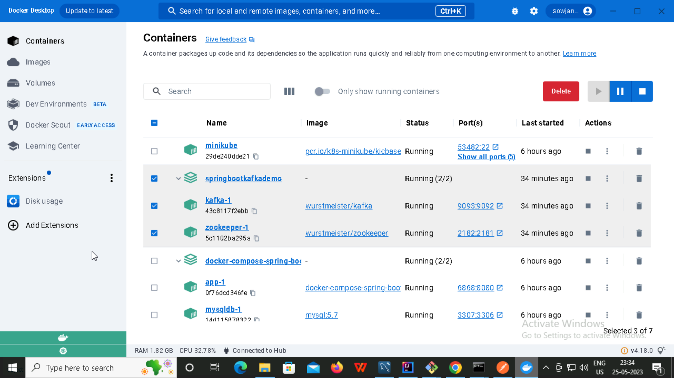
Running Docker

Slide 16
References
Youtube Link : https://youtu.be/aKDWWICgfA0
Youtube Link : https://youtu.be/q1kSBcueqYo
GitHub Link : https://github.com/SowjanyaMorisetty/java-fsd-advanced/tree/main/springbootkafkaDemo

